Slide 1

TEAM TAMAD
Gene Paul Zafra

Slide 2
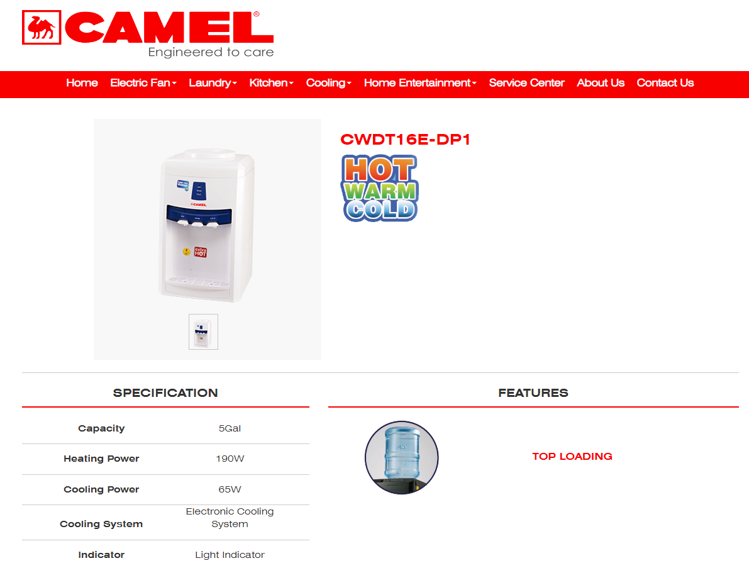

Slide 3
Usual temps for WATER in Refrigeration
Water is kept in cool 10-13 Degrees Celsius

Slide 4
Usual temps for WATER in Hot Water Dispensers
Water is kept in 80-94 Degrees Celsius

Slide 5
RULES
HEAT RULE |  | TANK LEVEL
 |  | S | M | L
TEMPERATURE | Ambient | MED | HIGH | HIGH
 | Warm | LOW | MED | MED
 | Hot | LOW | LOW | LOW
COOL RULE |  | TANK LEVEL
 |  | S | M | L
TEMPERATURE | Cold | LOW | MED | MED
 | Warm | MED | HIGH | HIGH
 | Ambient | HIGH | HIGH | HIGH

Slide 6
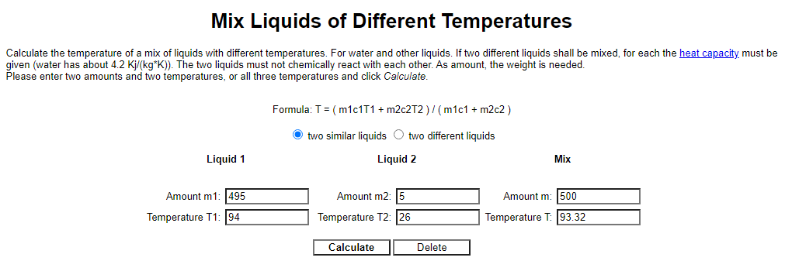

Slide 7
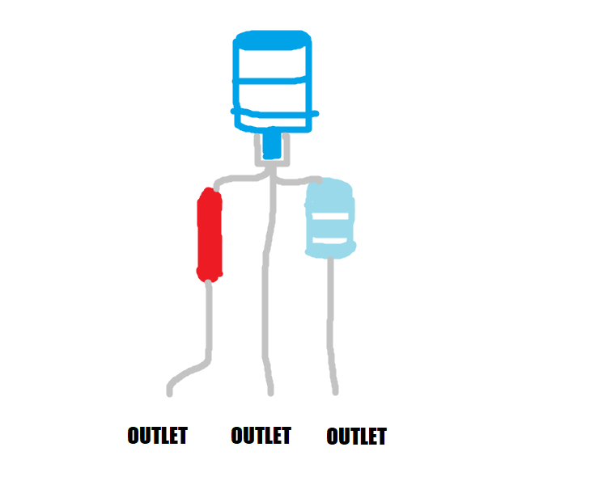
UPON DISASSEMBLY

